Slide 1
Digital Self Defense
Staying safe in the digital world
Jason Chambers, Engineering Manager, Cisco Stealthwatch
V1 June 2019

Slide 2
Disclaimer

Slide 3
Goals of the class – Provide know-how to
Prevent
Detect
Contain
Recover
Report

Slide 4
Why is this needed?
Digital lifestyle – online shopping, banking, correspondence, social media, entertainment/media, government, dating
Connected devices – fitness trackers, TVs, phones, webcams, washing machines, appliances, door bells, light bulbs, speakers, Alexa, cars
= Convenience.. for everyone (including the “bad actors”)
Exposes us to threats we may not be aware of
Technology can help keep us safe(r) – but it’s not enough

Slide 5
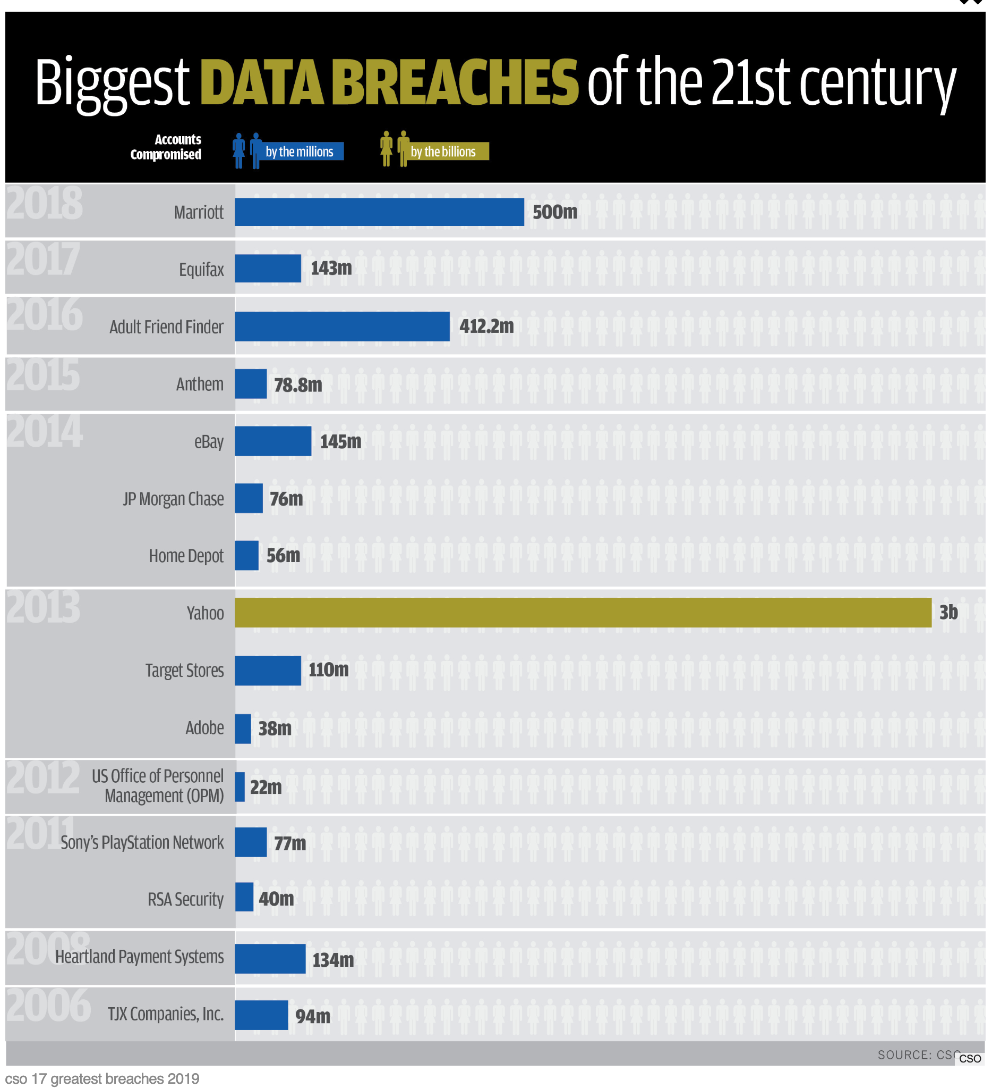
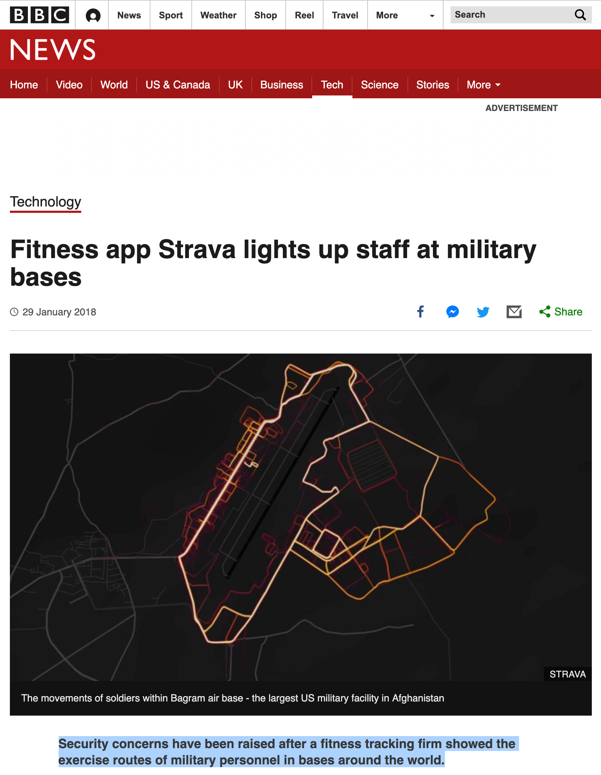
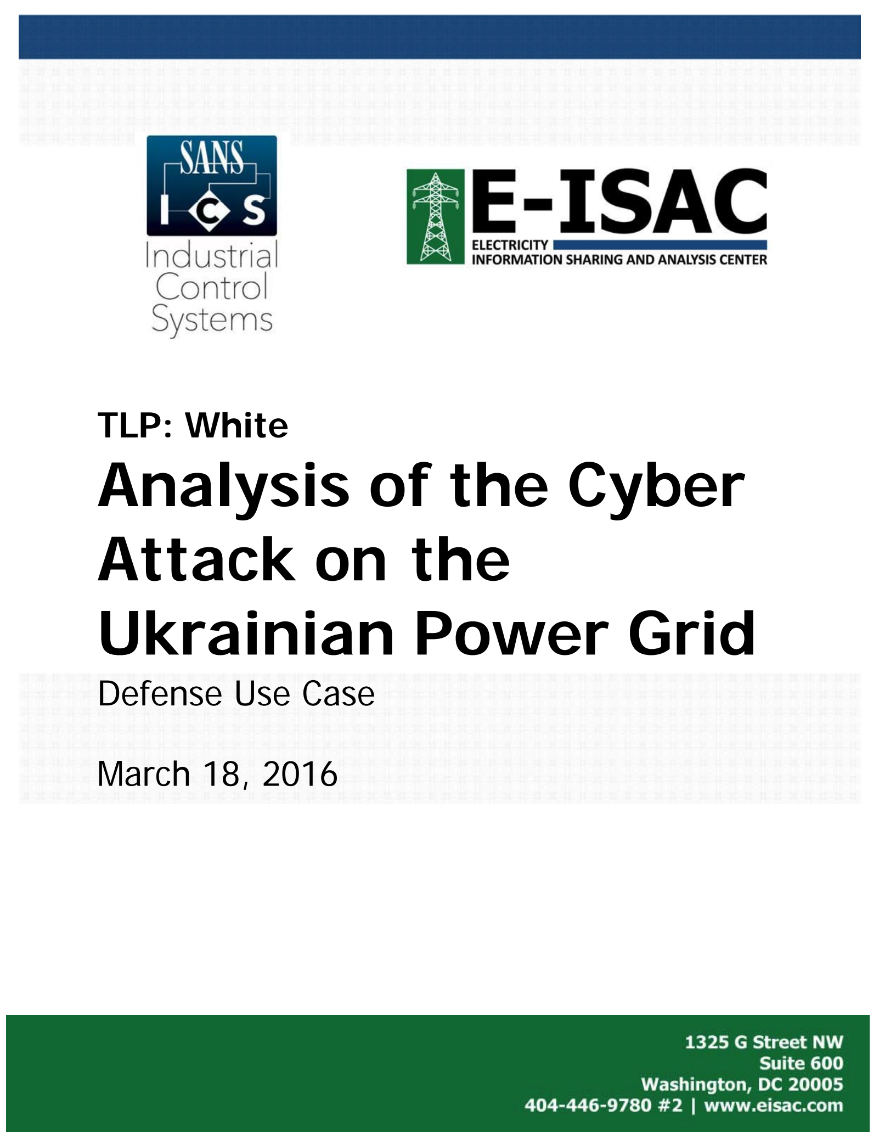
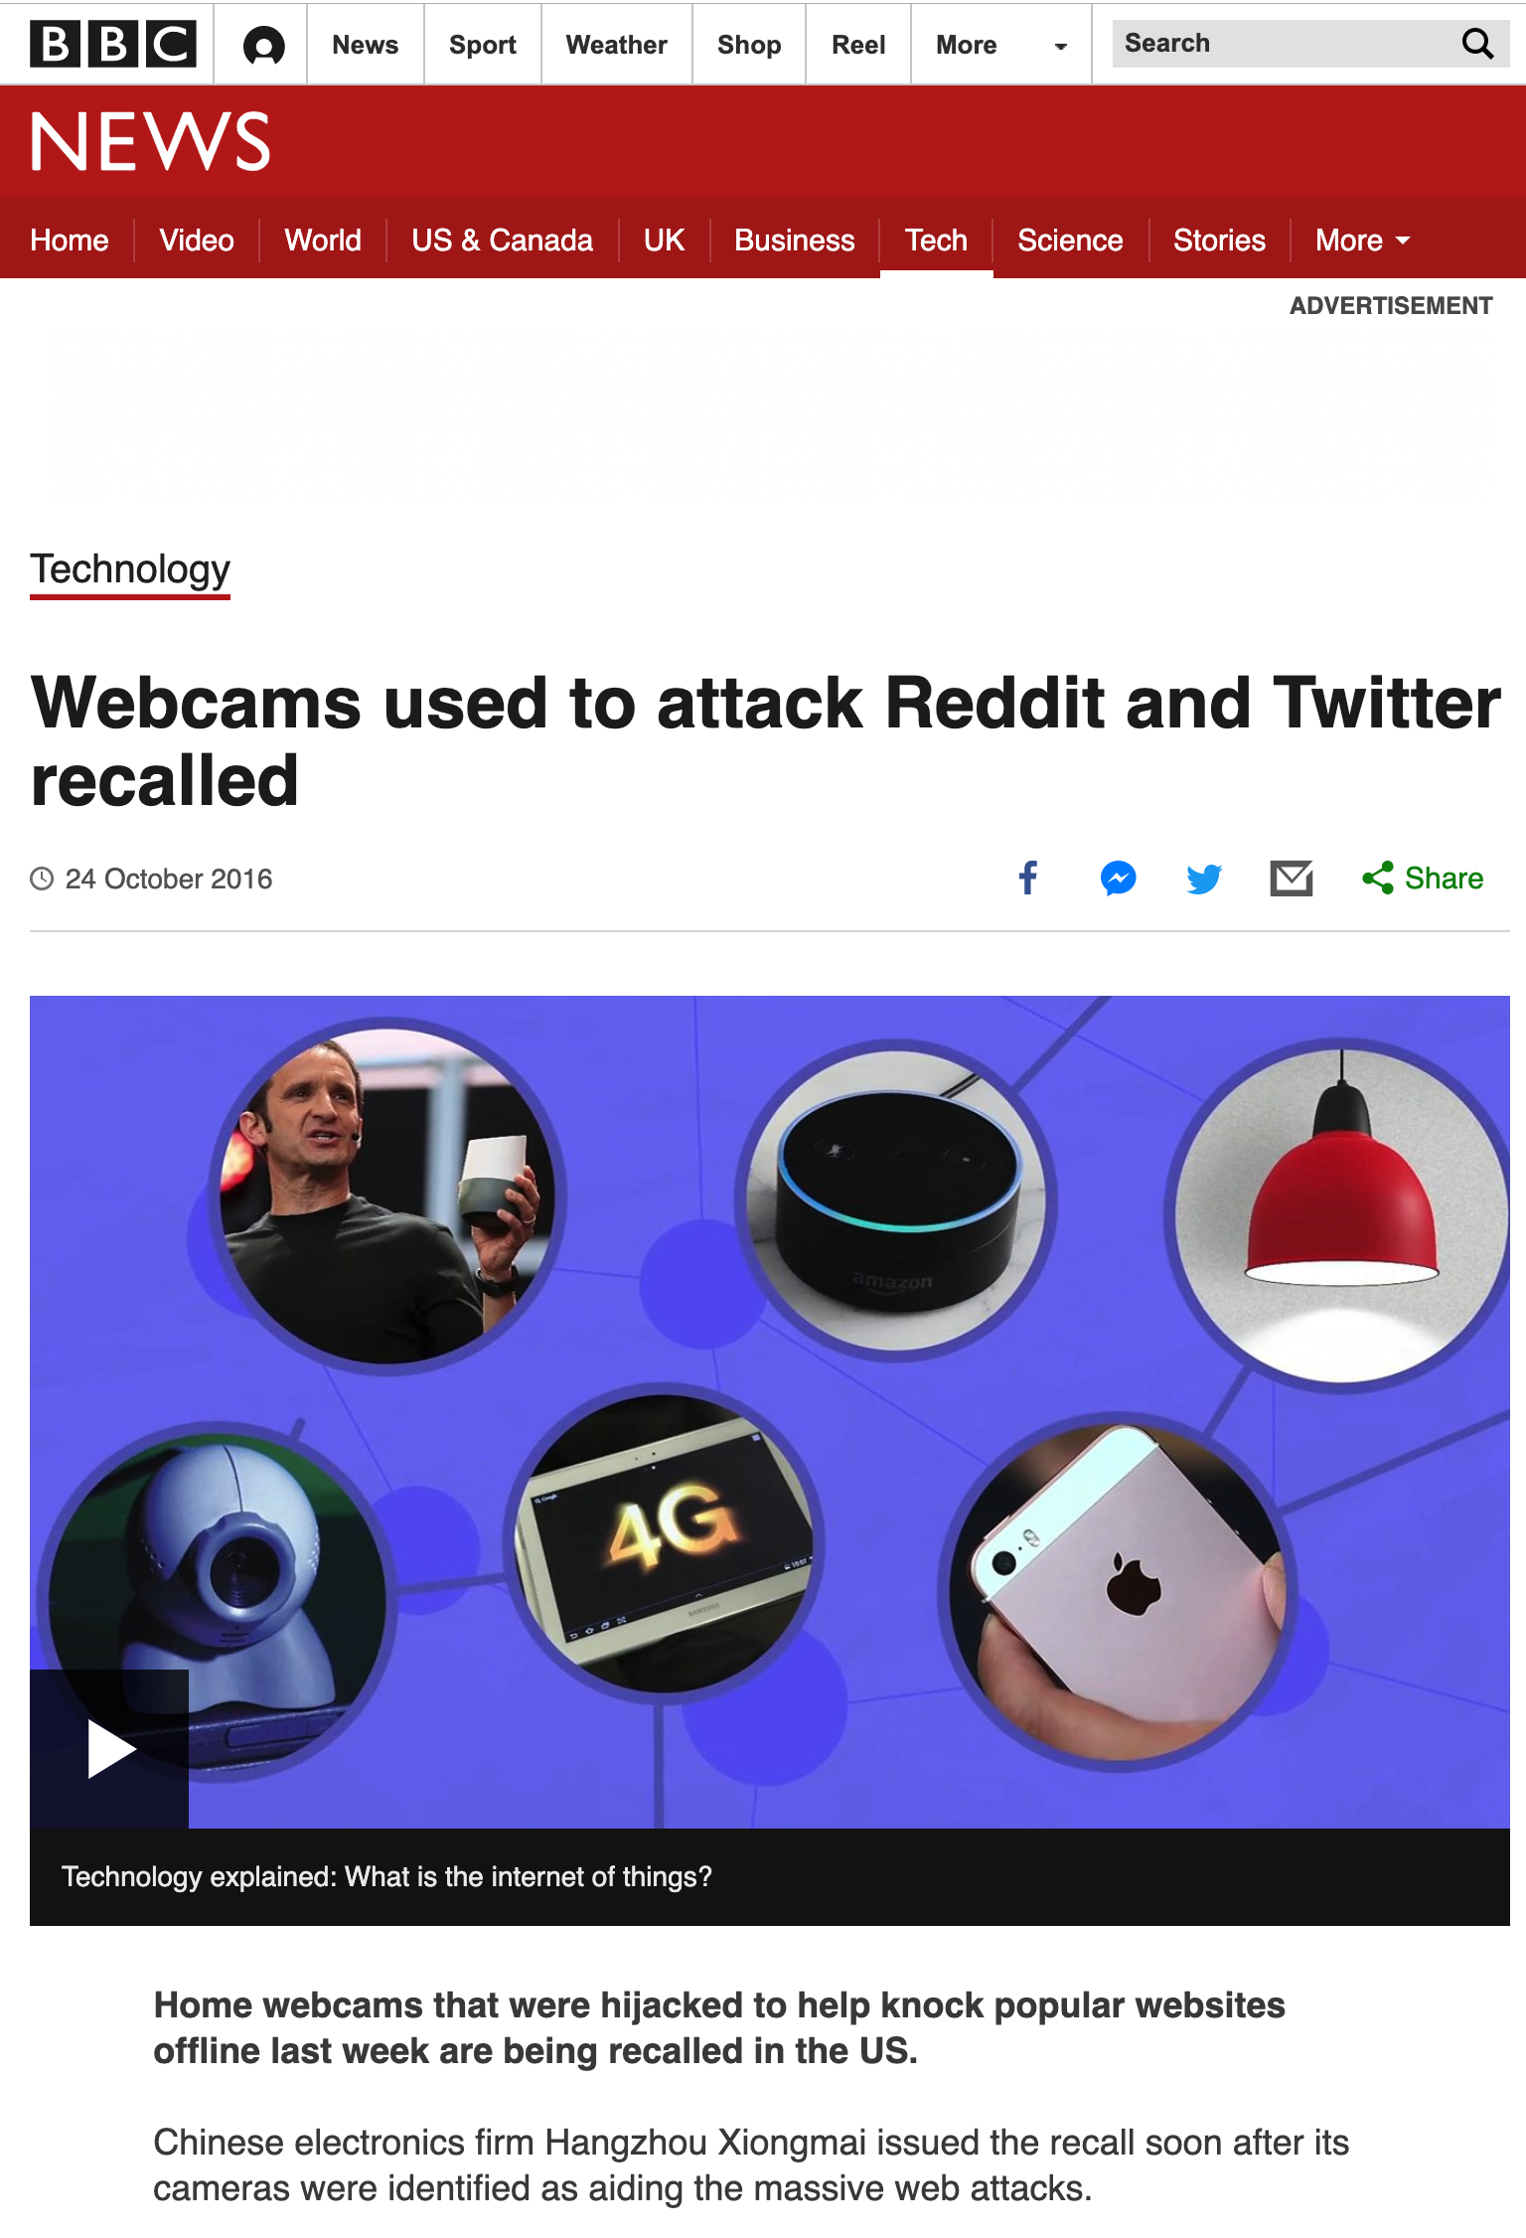
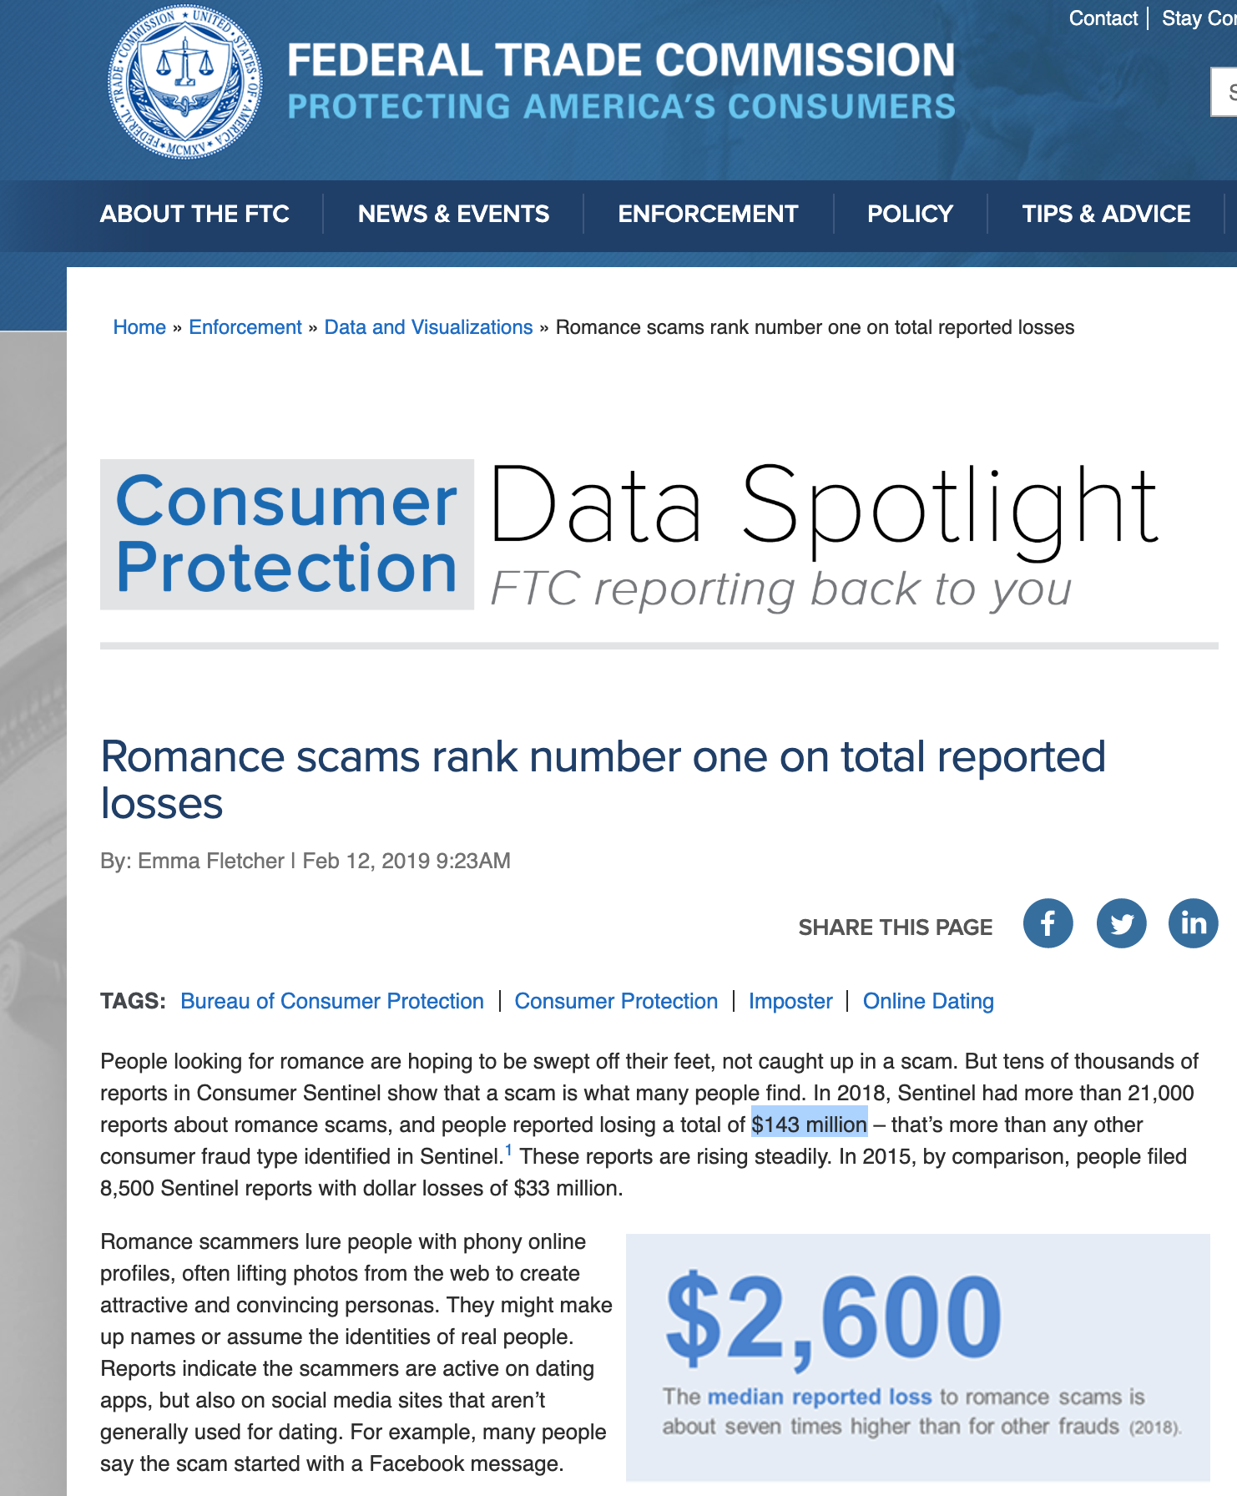
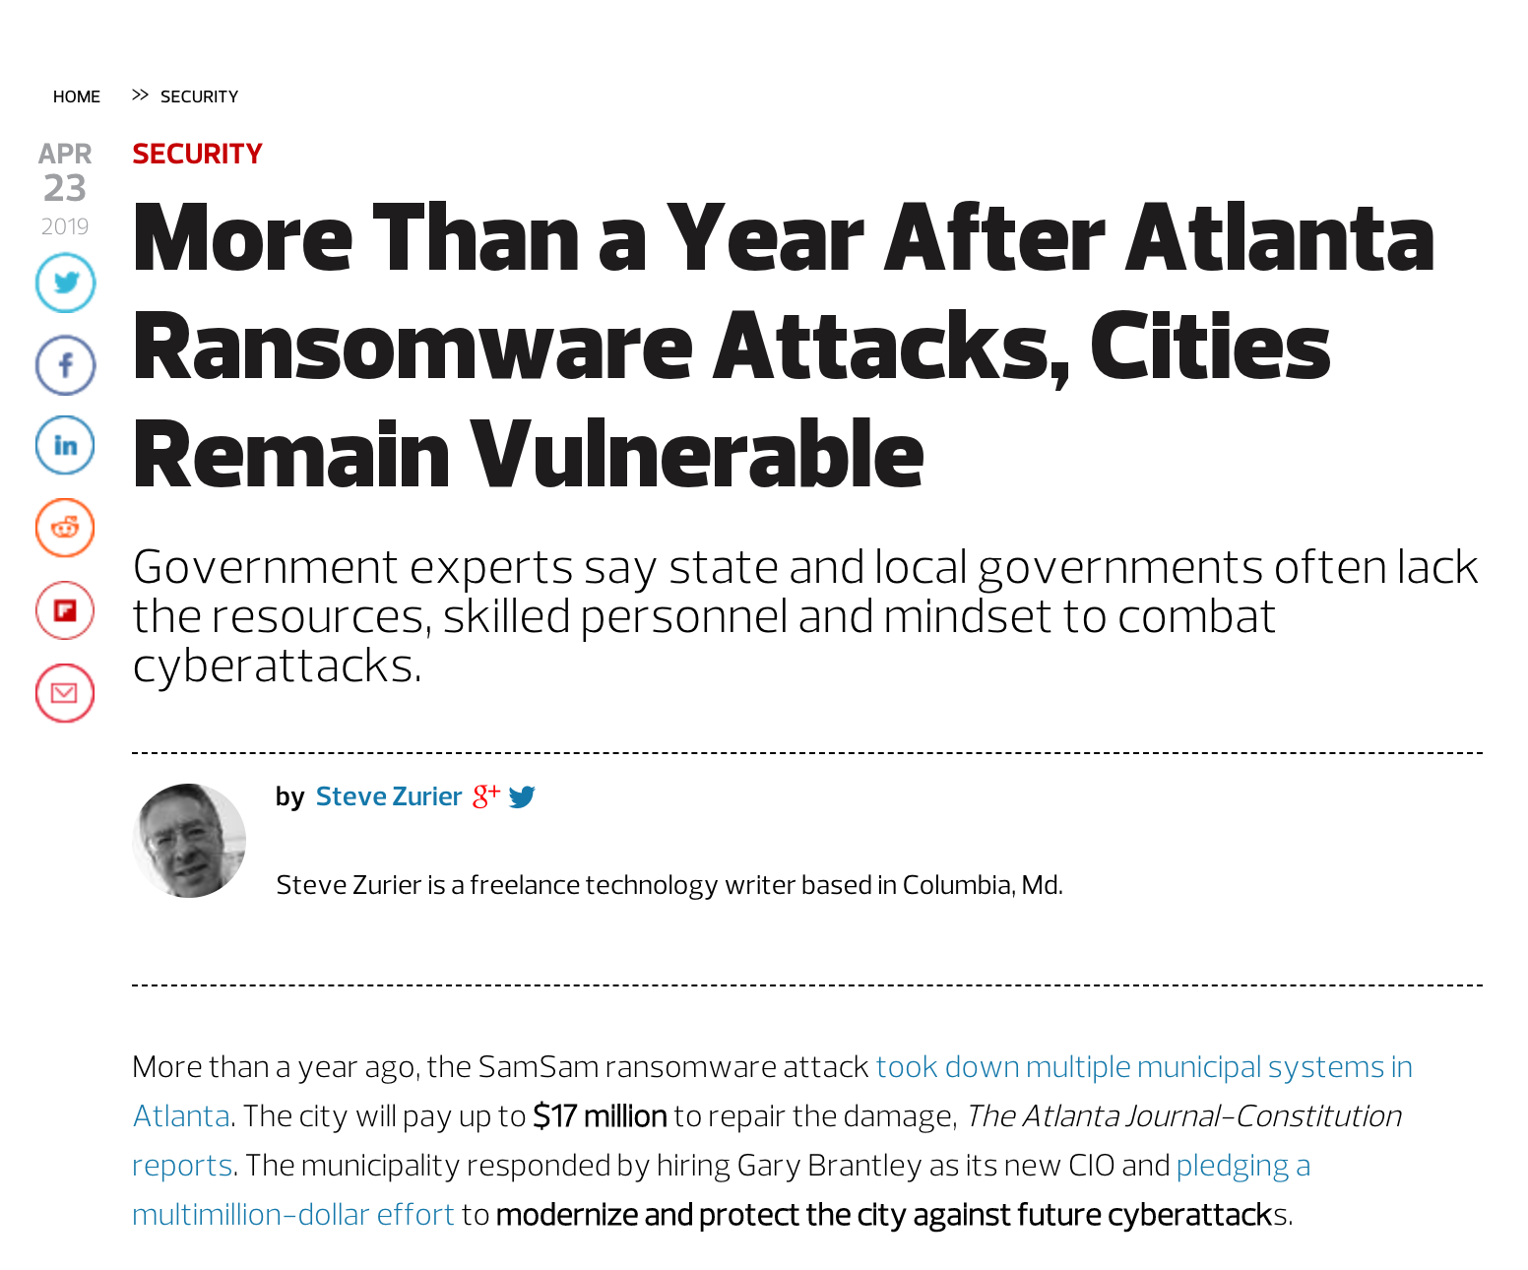
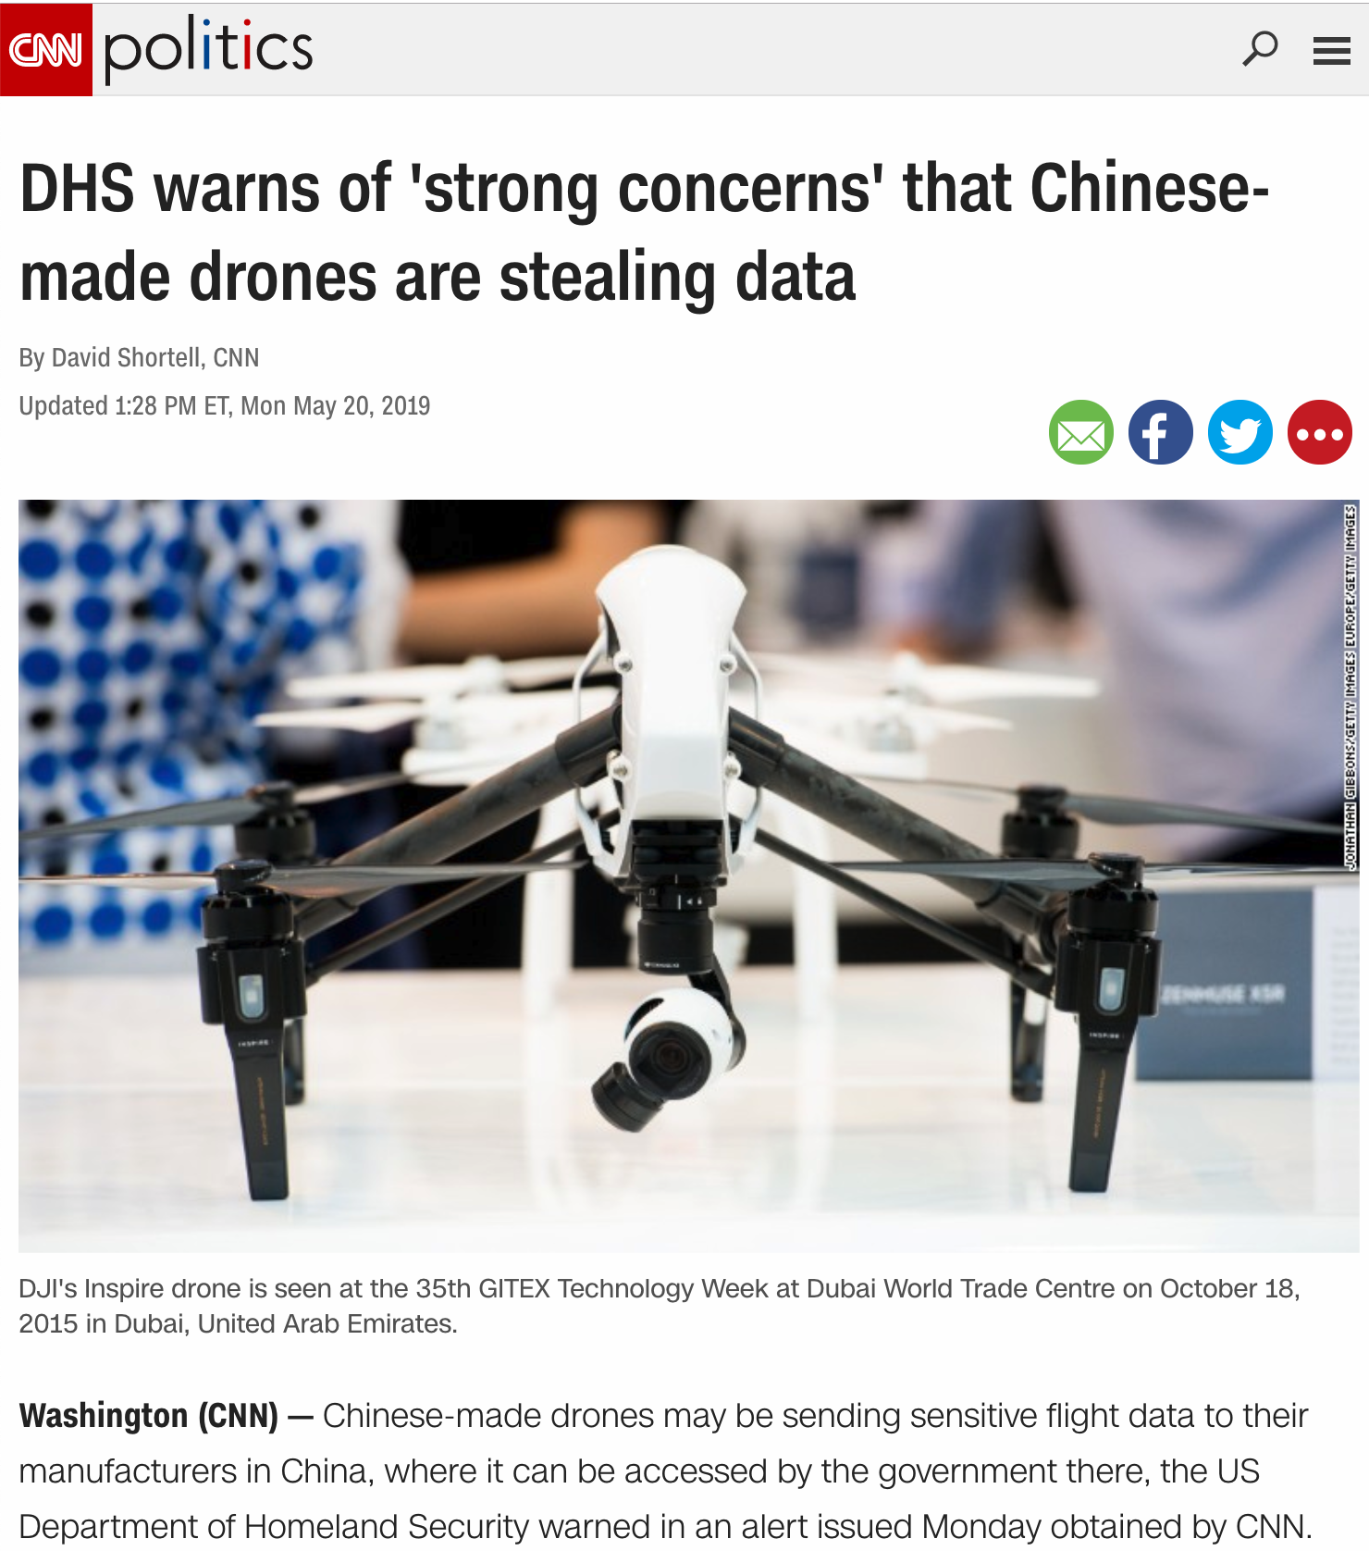
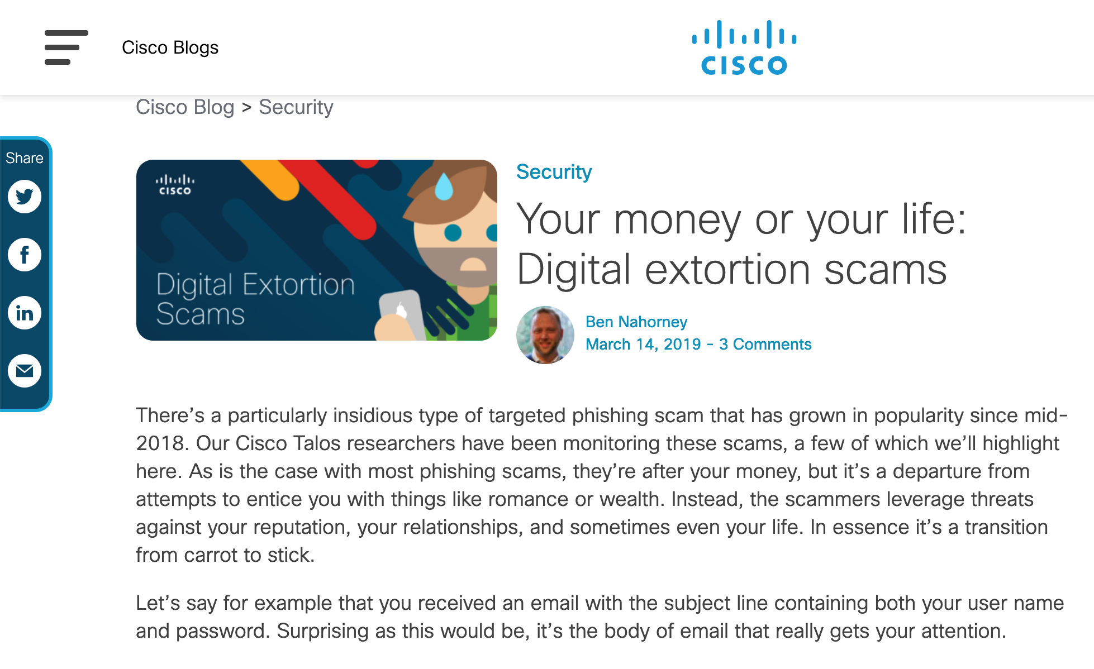
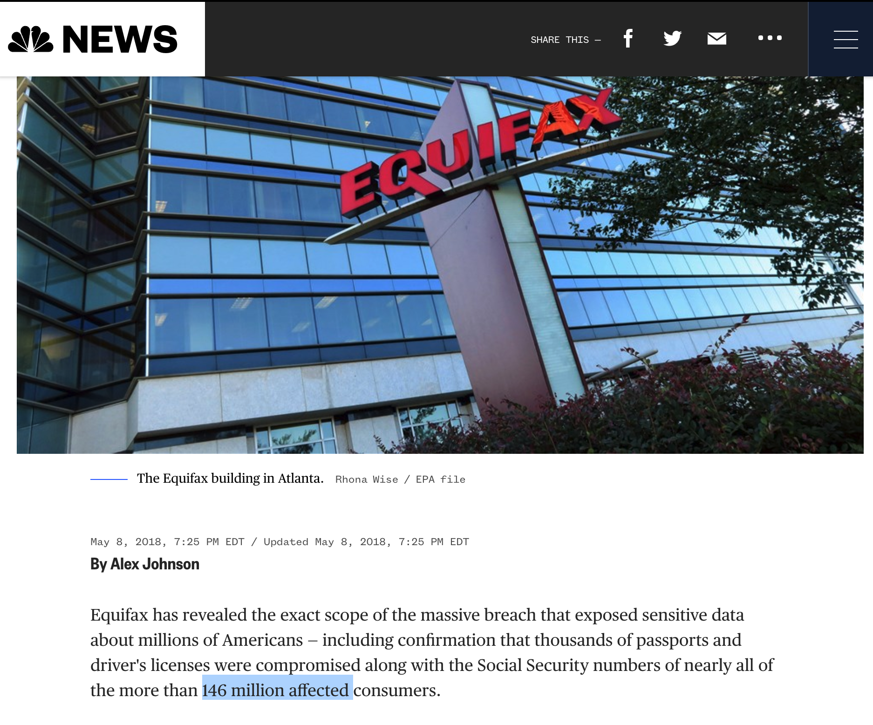
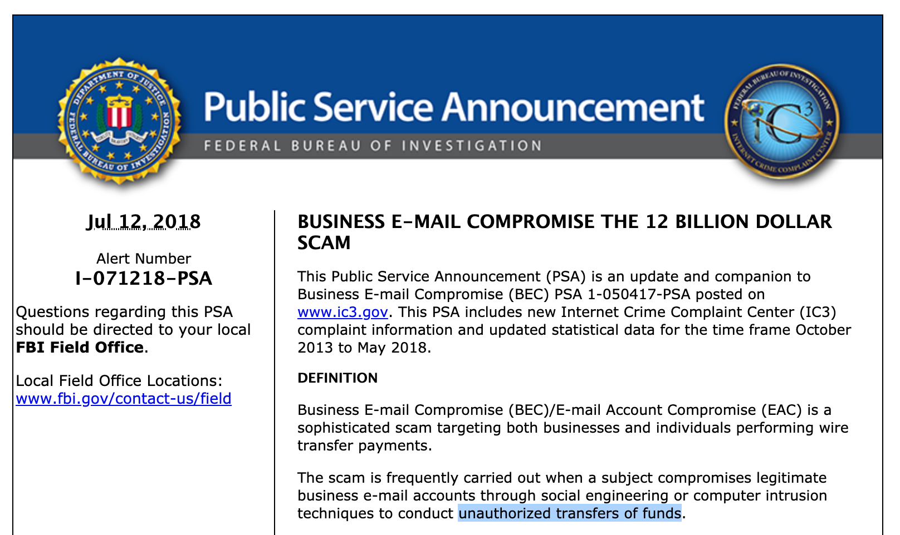
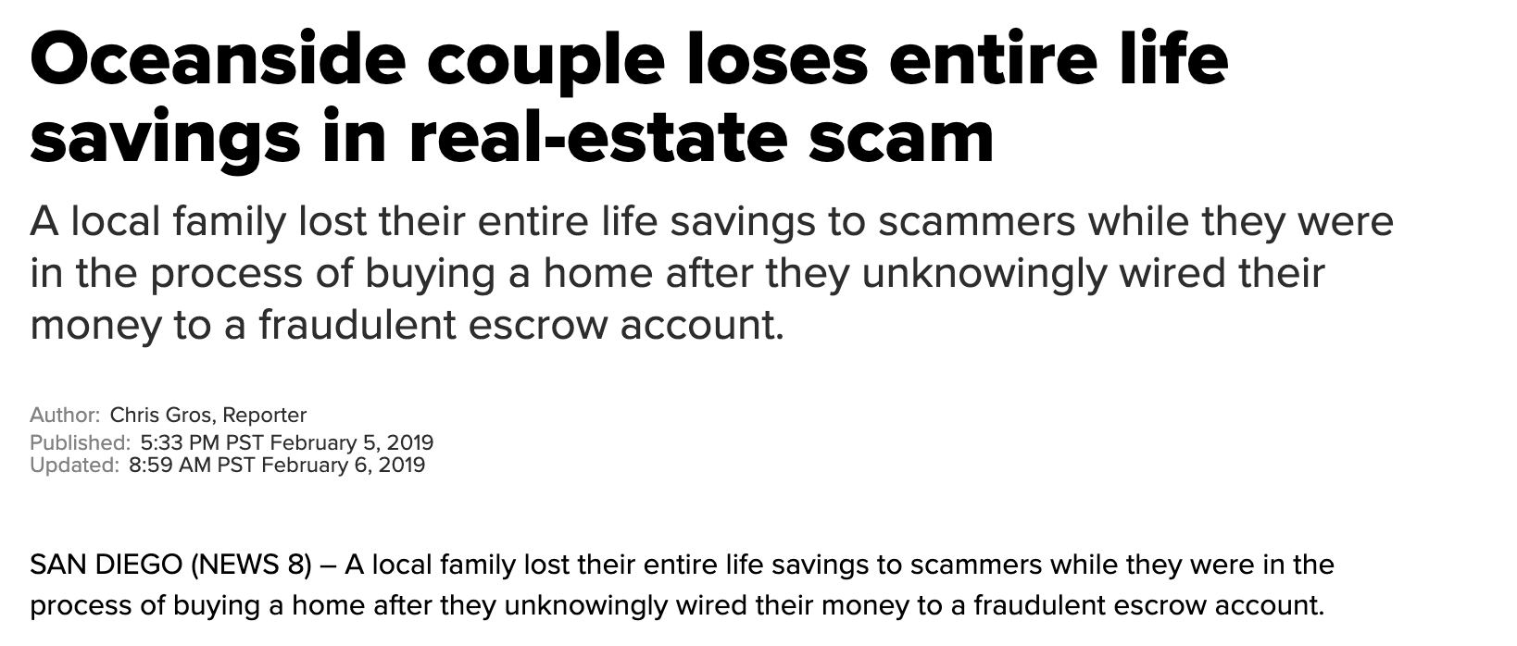
What can go wrong?

Slide 6
~$600B lost to cybercrime each year (~1% of global GDP)
Center for Strategic and International Studies – Feb 2018

Slide 7
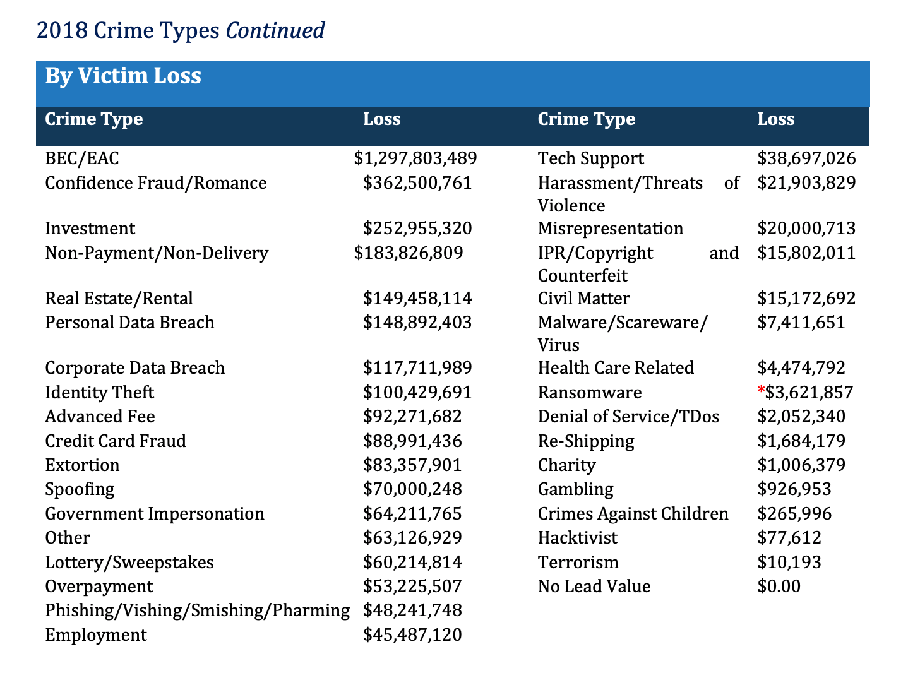
FBI 2018 Internet Crime Report

Slide 8
Risk and Consequence

Slide 9
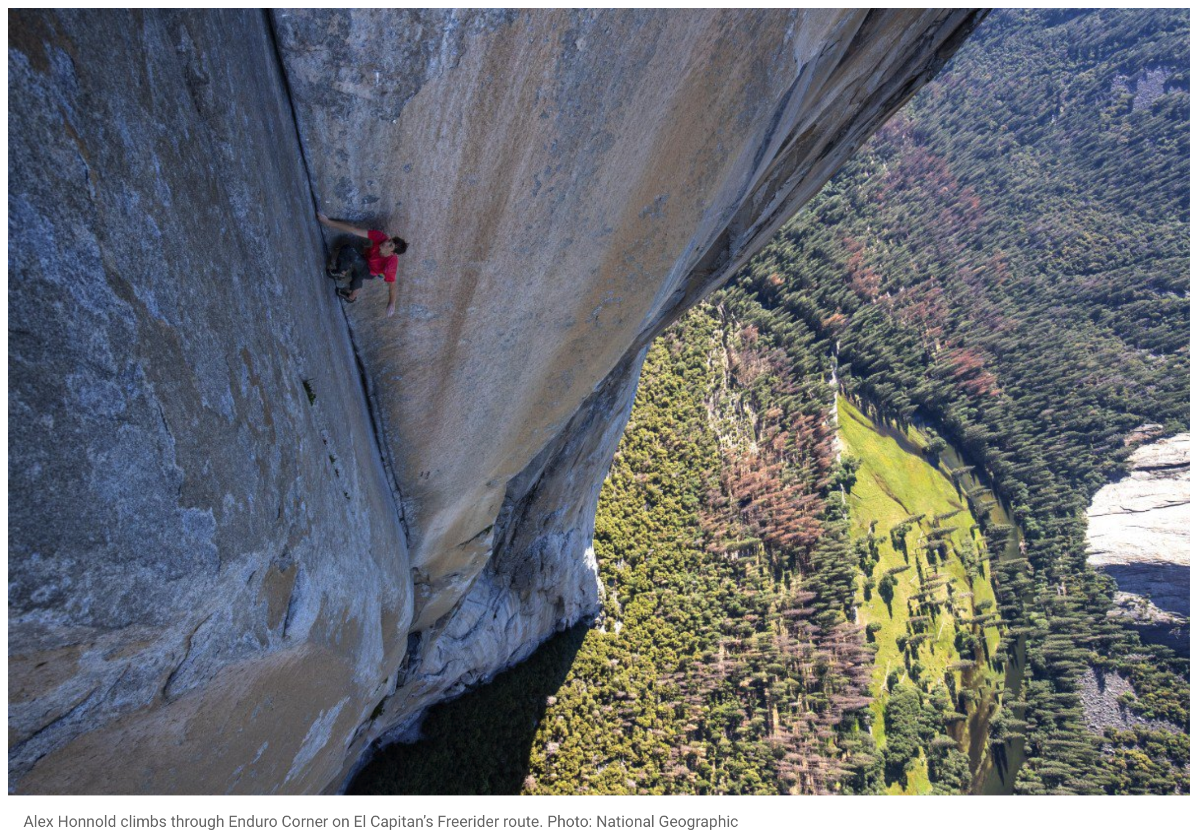

Slide 10
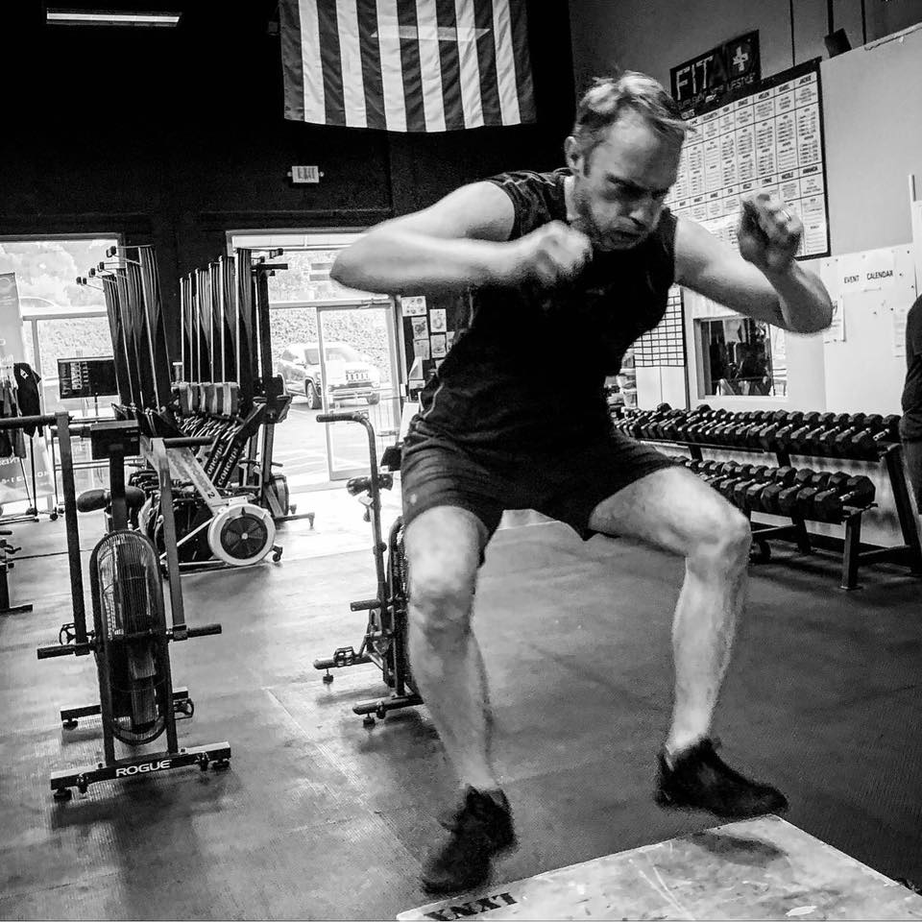

Slide 11

Photograph: Sipa Press/Rex/Shutterstock

Slide 12
What do you value? What is at risk? What are the consequences?

Slide 13
Low
High
Your defenses
Risk
Consequences
Cost to adversary

Slide 14
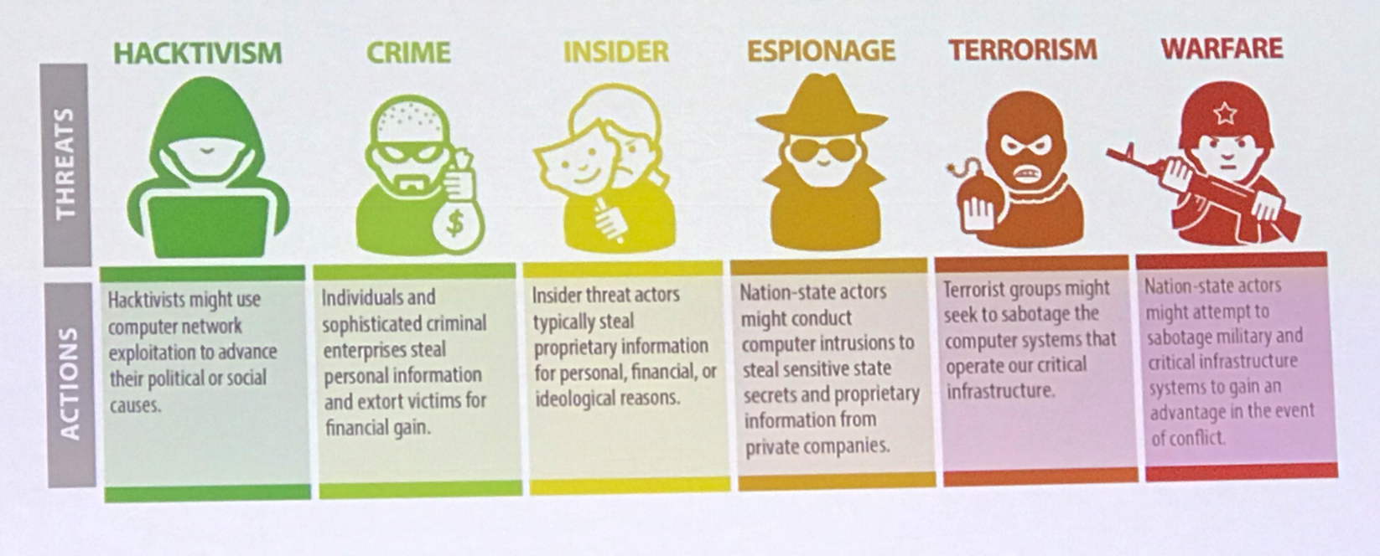

Know your enemy (Credit: FBI)
In addition, they want to infect your connected devices – so they can attack others – using your equipment!

Slide 15
How do they gain access to my accounts?
They need your login/password credentials
How?
Websites hacked (e.g. Marriot, Target, Home Depot,……)
They may already be “spilled out” there thanks to any one of numerous data breaches – they can be bought*
Malware – Keyloggers (DIY or buy Botnet-as-A-Service* )
Public Wifi
Brute force attempts (I will demo this)
Maybe you have it written down at your desk :-)
Phishing (DIY or buy Phishing-as-A-Service*)
<- 90% of all attacks on enterprise networks are the result of a successful phishing attack.
<- 97% of people are unable to identify a sophisticated phishing email
If your e-mail has been taken over, your other accounts can easily be taken over (thanks to “Reset Password” links)
If you use the same login/password everywhere, you are at risk of getting all your accounts taken over (Credit Stuffing)
* Criminals no longer need to be technically savvy

Slide 16
Why me?
It is unlikely you are a specific target for an attack
Exceptions are high-profile, public figures, celebrities, controversial figures, high-net worth individuals or work for a controversial organization
However, you are still vulnerable
A business you are interacting with could be a target (e.g. Mortgage Broker, Bank etc.)
Your friends could have their account compromised
You could fall victim to an opportunistic phishing campaign
A web-site you visit may have been compromised
You fail to keep your devices up to date

Slide 17
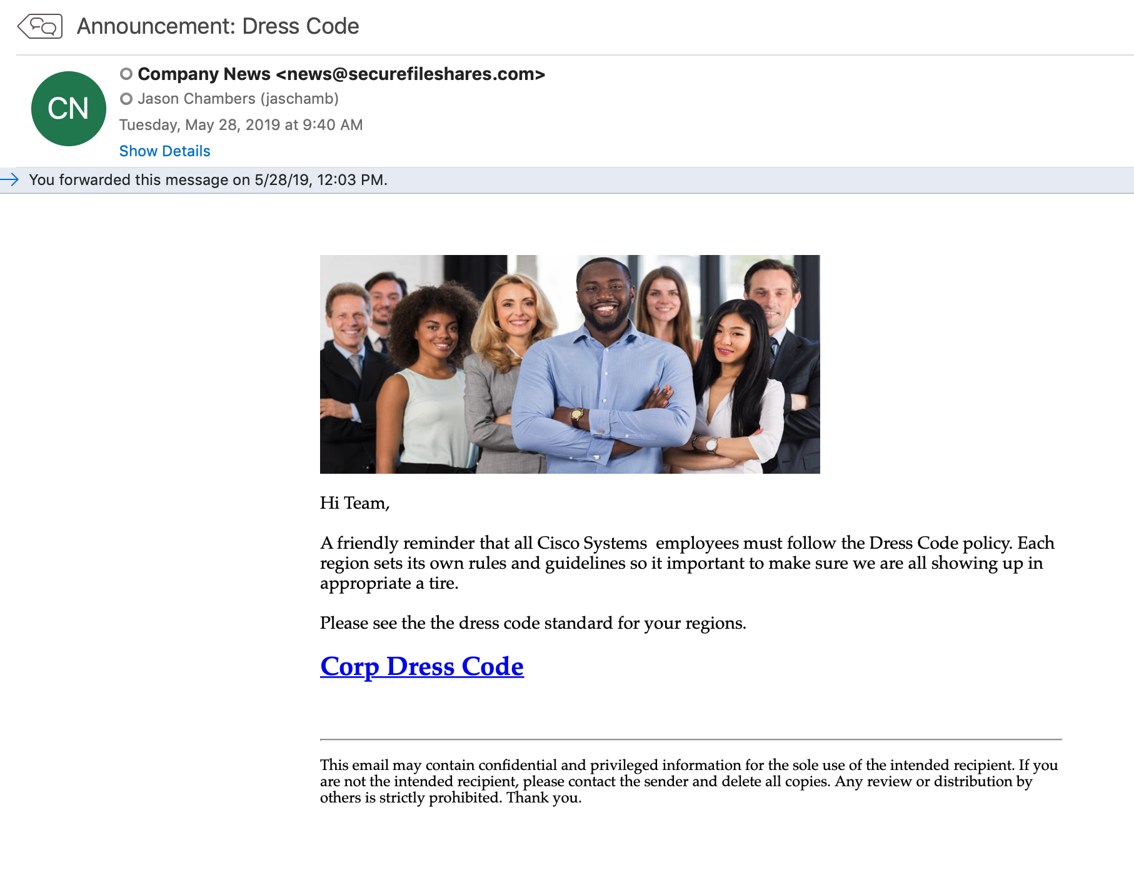
Is the message authentic?
- An unfamiliar tone or greeting
- Check for spelling and/or grammar mistakes in the message
- Unusual requests
- Did you initiate the conversation?
- Request for credentials, or payment information
Urgency
Fear
Greed
Curiousity

Slide 18
How might I boost my defenses and reduce risk?

Slide 19
Use a Password Manager

Slide 20
Change all your on-line passwords using a different strong password for each

Slide 21
Turn on 2FA for your accounts (start with e-mail)

Slide 22
Find out if you have been compromised (hint: you probably have been already)

Slide 23
Learn the signs of phishing campaigns

Slide 24
Don’t blindly assume a message or caller ID is authentic

Slide 25
Never give out personal or sensitive information until you have verified who you are talking to

Slide 26
E-mail (and SMS) is not confidential – encrypt sensitive files before sending them

Slide 27
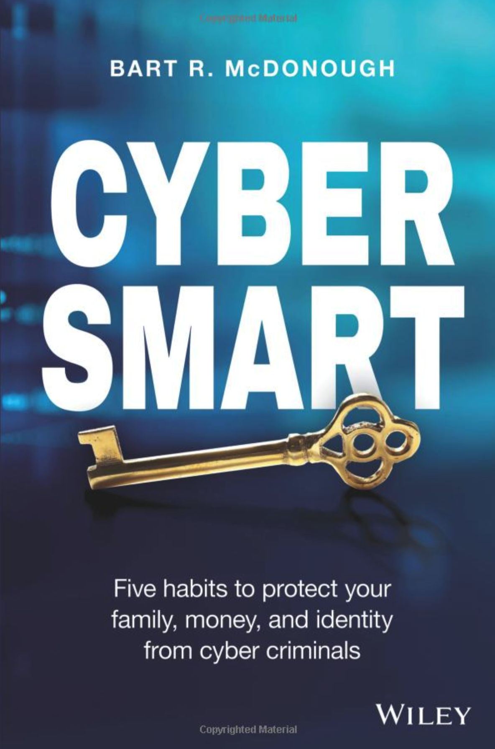
Buy this book

Slide 28
Freeze your credit

Slide 29
Monitor your credit

Slide 30
Monitor your banking activity (alerts)

Slide 31
Confirm wiring instructions over the phone AND lookup routing number and IBAN – never blindly trust e-mail messages

Slide 32
Be wary of on-line dating scams

Slide 33
Know it is easy to spoof Caller ID – it is not the IRS or Technical Support that is calling you

Slide 34
Invest in a secure on-line backup service (if you want to recover from a Ransomware attack)

Slide 35
Turn on hard-drive encryption – in case your laptop is stolen

Slide 36
Wipe clean your old Mac/PC/Device before selling/donating it

Slide 37
Take care using free public Wifi – use a VPN
(Be careful at airports especially)

Slide 38
Check https://haveibeenpwned.com/

Slide 39
Spread the word

